Slide 1
Ensuring a Superior User Experience with Web 2.0 Applications
Patrick Lightbody
QA Solutions Product Manager
Gomez

Slide 2
Agenda
Yesterday’s Mediocre Experience
  Why a poor process still managed to produce a decent user experience
Today’s Poor Experience
  Why the user experience is worse – even with an improved process
Tomorrow’s Superior Experience: A look at…
  New tools that help (Firebug, Selenium, etc)
  New performance constraints and requirements
  How test definitions are changing because of AJAX
  Modifications needed to today’s continuous integration process

Slide 3

But First… The Safari Experience
Any Mac users in the audience?
Book a hotel at www.lasvegas.com:
  Click the calendar icon
  Move to the next month
  Select a date -- ERROR!
Like 24? Go to www.fox.com
  ERROR!
Safari represents < 5% of the market share…
  … can you imagine if your local grocery store decided to refuse service to 1 out of every 20 customers?

Slide 4
Experience Criteria
The top three criteria for a super user experience are:
  Works reliably: the application must do what it claims it can do, and it must do it every time.
  Looks good: the application must not have any graphical and design flaws.
  Performs quickly: the application must respond at least as fast as the user can work.

Slide 5
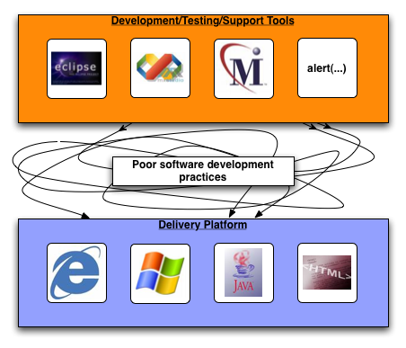
Yesterday’s Mediocre Experience

Slide 6
Poor Process, Decent Experience?
Fewer delivery vehicles led to fewer post-production surprises.
Developers often uses the same browser/OS as end-users, catching bugs earlier.
English-language test definitions mapped closely to page-level transactions.
Basic tools available worked on the limited delivery vehicles.

Slide 7

User Experience Report Card
Report Card
Subject
Grade
Reliability: Simple applications ==
less to break
A-/B+
Appearance: Web 1.0- gray backgrounds, ugly fonts, etc
C-
Performance: While slow by today’s standards, expectations were lower
B
Overall: Mediocre
C+

Slide 8
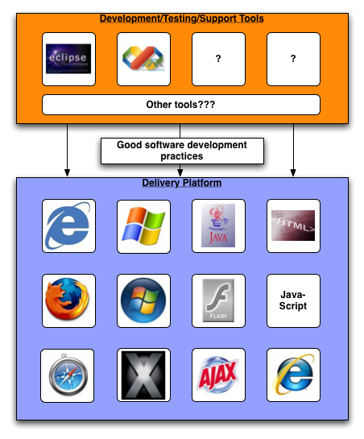
Today’s Poor Experience

Slide 9
Decent Process, Poor Experience?
Developers are now using a browser/OS that is different from the end user.
More logic is now run inside of the browser: the very concept of “JavaScript frameworks” barely even existed two years ago.
More content is beyond your control and is assembled inside the browser: AdSense, Google Analytics, Akamai, etc.

Slide 10
Yesterday’s Tools Don’t Cut It
Lack of tools available to test on all the new delivery vehicles.
  Most commercial tools today only cover IE6 and, more recently, Firefox.
  Always playing catch-up to market trends: Safari, Firefox 2.0, IE7, Opera, mobile devices, etc.
The “one-page-equals-one-step” mentality no longer works (more on this later).
  English-language test descriptions no longer map as cleanly to automated tests – damaging automation efforts.

Slide 11
User Experience Report Card
Report Card
Subject
Grade
Reliability: complex apps +
many delivery vehicles = poor reliability
F
Appearance: Web 2.0- rounded
corners, bright colors, rich interactions
A-
Performance: Ajax makes apps appear faster, are browsers capable?
B-
Overall: Poor
D-

Slide 12
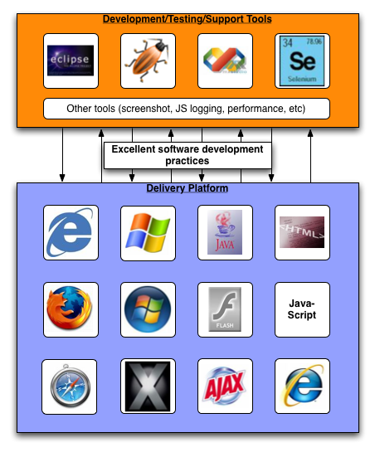
Tomorrow’s Superior Experience

Slide 13
The Solution
Reliability is the biggest problem
Performance is not too far behind
What can we do?
  Software processes (continuous integration, development, automated testing, and manual testing) must adapt to work with these new complexities and constraints.

Slide 14
Tools that Help
Selenium – play back automated tests on any browser/OS
Firebug – debug JavaScript and introspect CSS/HTML; lots more (Firefox only)
Firebug Lite – Provides logging and profiling support found in Firebug (All browsers)
Visual Studio 2005 – Excellent JavaScript debugger for IE
Drosera – JavaScript debugger for WebKit (the foundation of Safari)
HttpWatch – Watch HTTP traffic on Windows

Slide 15
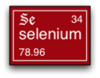
Selenium
Web browser automation toolkit.
Core engine is 100% JavaScript – can run on any browser.
Several sub-projects:
  Selenium Core
  Selenium IDE
  Selenium on Rails
  Selenium Remote Control (more in a moment)

Slide 16
Selenium Example
Command | Locator | Value
open | http://www.google.com
type | q | Selenium
clickAndWait | btnG
verifyTextPresent | OpenQA

Slide 17
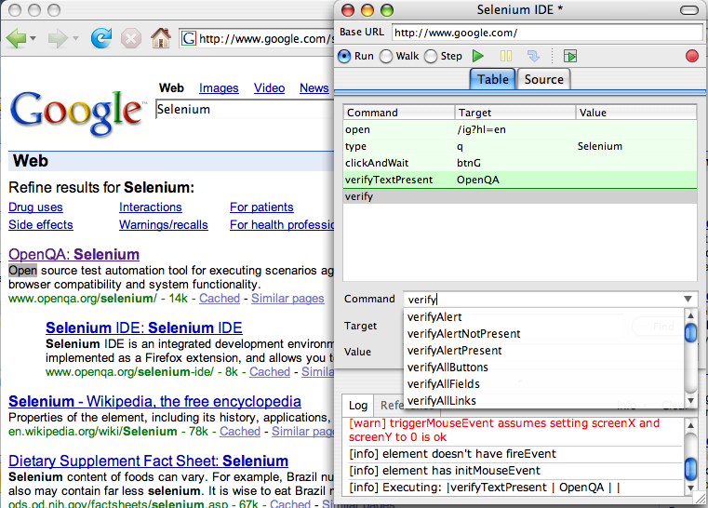

Slide 18
Selenium for
Cross-Platform Testing
Selenium Remote Control
  Provides language-specific bindings in .NET, Java, perl, Python, Ruby, and PHP
  Automates the process of setting up the browser
  Non-invasive setup (As opposed to Selenium Core)
Homework: set up many physical/virtual machines to represent all the test environments; install Selenium RC
Homework: A picture is worth… a lot of frustrating debugging sessions - capture screenshots/movies for each test

Slide 19

Firebug
Amazing Firefox-only developer toolkit
  JavaScript debugger
  Network traffic analyzer
  JavaScript logging utility
  JavaScript command line console
  HTML and CSS editor/introspector
  JavaScript profiler and timer

Slide 20
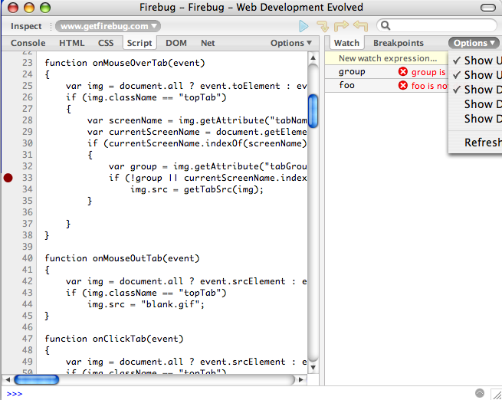

Slide 21
JavaScript Logging
Too much logic in the UI to not log anymore.
Use console.log()
  Firebug adds Firefox support
  Safari has built in support
  Use Firebug Lite for IE and other browsers
Homework: recapture this information during automated tests and during production.

Slide 22
Evolving Test Definitions
The disconnect between acceptance tests written in a natural language and those consumed by automation tools has grown
Web 1.0: each “transaction” (set of steps) or click was almost always a new page view/request.
Web 2.0: some applications (Gmail, Live.com, Yahoo Mail, etc) are now only a single “page”.

Slide 23

Example Test Definition (6)
Go to http://acmebank.com
Click “Log In”
Type “fred” in the username field
Type “fr3drul3s” in the password field
Click the “Log In” button
Click the “Transfer Funds” button
…

Slide 24
Web 1.0 Example (6)
Command | Locator | Value
open | http://acmebank.com
clickAndWait | link=“Log In”
type | username | fred
type | password | fr3drul3s
clickAndWait | login
clickAndWait | link=“Transfer Funds”
…

Slide 25
Web 2.0 Example (10)
Command | Locator | Value
open | http://acmebank.com
click | link=“Log In”
waitForElementPresent | login_div
type | username | fred
type | password | fr3drul3s
click | login
waitForElementNotPresent | login_div
waitForTextPresent | Transfer Funds
click | link=“Transfer Funds”
waitForElementPresnet | transfer_div
…

Slide 26
Consequences of this Evolution
Selenium is great for this:
  *AndWait for Web 1.0
  waitFor* for Web 2.0
Test refactoring is more important:
  As the implementation of the application changes, tests often will need to change
  Suppose transfer_div is now pre-loaded but just hidden… now waitForElementPresent won’t work as expected
Homework: implement a process and/or tool that assists with managing test refactoring

Slide 27

Assessing Performance in AJAX
Performance is now about perception, not HTTP response time
  Individual JavaScript functions/AJAX calls affect perceived performance
  Knowing the time to display a div (ie: transfer_div) involves timing more than just HTTP response time
Three types of performance metrics
  Individual object performance (images, CSS, HTML, etc)
  JavaScript function profiling
    Firebug/Firebug Lite provide console.profile()
  HTML-specific events (DOM-ready state, onload, etc)
Homework: capture performance data during Selenium tests

Slide 28
Changes to Continuous Integration
Most CI systems today don’t test the web-layer of an application
  … of if they do, they usually emulate it (HttpUnit/HtmlUnit, etc)
AJAX is now a major part of the application, so we must include it in the CI process

Slide 29
Challenges with
Continuous Integration
Testing on real browsers requires much more testing infrastructure (multiple machines, browsers, browser configuration).
More information must be captured from within the browser, but there is no standard mechanism for storing this data (ie: JUnit XML structure).
Today’s automated tests require more intimate knowledge of the inner DOM, which often requires better data consistency/test fixtures.
Final Homework: Implement a CI system that allows for full integration on every commit.

Slide 30

Your Homework Recap
Set up various delivery vehicle platforms (OS/browser/etc).
Capture screenshots/movies during automated tests.
Capture logging during automated tests and production.
Refactor tests as the underlying implementation evolves.
Capture performance metrics during automated tests and production.
Do all of this in a continuous integration environment.

Slide 31

Not Feeling Very Scholastic?
Following the sheep!
Stop by the Gomez booth
and learn about Browzaah.

Slide 32
Questions?

